Slide 1

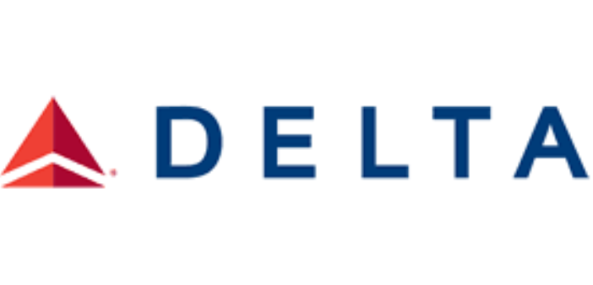
AI Software Development Proposal:
Delta IT Applications
Corderio Vonner
February 3rd 2026

Slide 2
Core Values (Delta’s Heart)
Care - Prioritizes concern for people, customers & communities
Integrity - Act honestly and ethically
Resilience - Adapt and persevere through challenges
Servant Leadership - Lead by serving others
Teamwork - Collaboration across teams
Key Values & Commitments (Delta’s Culture)
Purpose & Culture - Connect people to opportunities and to each other through global travel.
Diversity, Equity & Inclusion (DEI) - Connect the world. Reflect the world. Respect the world.
Sustainability - Become Net Zero by 2050. Reduce waste. Innovate for sustainable travel.
Community Engagement - Invest in progress. Cultivate caring relationships. Be a strong partner.
Operational excellence & reliability - Maintains high standards in service and performance.
Employee well-being & workplace culture - Fosters a thriving, inclusive work environment.
Corporate citizenship & community impact - Being the most community-minded company in US.

Slide 3
Goal: To Design, Develop & Deploy 3 AI-driven applications to enhance Delta’s IT ecosystem
DeltaChat AI
AI Customer Interaction Chatbot - Conversational AI for customer interaction.
CodePilot AI
Intelligent Code Assistant - Developer productivity and code optimization.
DeltaOps AI
Predictive ML Agent - System monitoring for Delta’s core IT infrastructure.
Each AI solution leverages AWS serverless architecture, CI/CD pipelines,
DevOps best practices, AI/ML frameworks, and Delta’s Agile methodology.

Slide 4
DeltaChat AI - AI Customer Interaction Chatbot
Automate customer interactions across Delta’s platforms, providing self-service & personalized responses.
Requirements Analysis Define KPIs: Response Time, TTR & 24/7 uptime
Gather common Delta customer inquiries (ticketing, baggage, flight updates).
Architecture Design AWS Lex Gen AI V2: conversational understanding
AWS Lambda, API Gateway, DynamoDB, S3, EventBridge, SNS/SQS, Step Functions.
Conversation Flow Design AWS Connect: customer interaction routing
Map customer intents. Build decision trees. Implement fallback & escalation logic.
Data Pipeline & Integration EventBridge, SNS, SQS & Step Functions: collect real-time customer queries
Collect web, mobile & call center queries. Store conversation logs in Amazon S3 buckets.
AI Model Implementation Lambda: context retention using session attributes & conversation logs
Fine-tune pre-trained models (Claude or GPT-based) with Delta-specific domain knowledge.
Deployment & CI/CD AWS CloudFormation or Terraform: Infrastructure-as-Code (IaC) development
Run unit tests using Test-Driven-Development (TDD) & integration tests with BDD frameworks
Monitoring & Maintenance AWS CloudWatch & Lambda logs: monitor performance & track system behavior
Improve intent accuracy. Automate SNS/SQS alerts. Notify failures or anomalous behavior.

Slide 5
CodePilot AI - Intelligent Code Assistant
Assist Delta developers by Automating code generation, review, optimization & improving microservices productivity.
Requirements Analysis Define KPIs: Reduce code review time by 40%, catch 90% of syntax/logic errors
Identify repetitive coding tasks: boilerplate code, API integration, serverless functions.
Architecture Design AWS Lambda + ECS Fargate: Host microservice-based AI applications
API Gateway integrates IDE plugins while DynamoDB provides persistent storage for code snippets & training data.
AI/ML Implementation PyLint/Checkstyle/ESLint pipelines: Integrate static code analysis
Use fine-tuned LLMs on Delta’s codebase with embeddings & semantic search for code reuse suggestions.
Automation & Workflow Lambda Functions: Evaluate suggestions & provide automated code review comments
Integrate Jenkins/GitHub Actions to trigger AI suggestions & perform automated CI/CD checks on PRs & code commits.
Testing Jenkins CI/CD pipelines integrated with PyLint, Checkstyle, & ESLint for automated static code analysis
A/B testing to compare AI suggestions vs. manual developer actions & run Unit tests for AI-generated code snippets.
Monitoring & Maintenance AWS CloudWatch & Lambda logs: monitor performance & track system behavior
Establish an active feedback loop to continuously improve model predictions using (RLHF)

Slide 6
DeltaOps AI - Predictive Maintenance & Performance Analyzer
Continuously monitor Delta’s IT infrastructure & predict potential failures or performance bottlenecks.
Requirements Analysis Define KPIs: Reduce system downtime by 50%, predict anomalies with 95% accuracy
Identify repetitive coding tasks: boilerplate code, API integration, serverless functions.
Architecture Design Data Ingestion: CloudWatch logs → Kinesis Data Streams → S3/Redshift
AWS Lambda & Step Functions for event-driven workflows, with Python predictive models using TensorFlow & PyTorch.
Feature Engineering Generate time-series datasets for anomaly detection models
Extract & monitor KPI metrics: CPU usage, memory consumption, API response times, & Lambda execution duration.
Model Development AWS SageMaker: Deploy models for supervised and Unsupervised learning
Random Forest & XGBoost for failure prediction. Autoencoders & Isolation Forest for anomaly detection.
Visualization & Alerts QuickSight: Dashboard that shows system health metrics & predicted failures
Real-time alerts via SNS for critical incidents & integration with 3rd party applications for incident response automation.
CI/CD Maintenance Jenkins pipeline: LLM & SML retraining, RLHF & Lambda updates
Continuous monitoring of performance benchmarks, model drift, retraining triggers based on accuracy thresholds.

Slide 7
Proposal Summary:
Each AI solution’s workflow describes a fully automated, AI-driven monitoring system on AWS:
Collecting data via CloudWatch, Kinesis, S3 & Redshift
Orchestrating workflows with Lambda, Step Functions, CloudFormation,
Integrating AI interactions via EventBridge using AWS Lex Gen AI V2 and AWS Connect
Running predictive models, visualizes insights via Quicksight & triggers real-time alerts via SNS/SQS
Continuously improving models by automated retraining Reinforcement Learning from Human Feedback
Integrated into real-time CI/CD pipelines that continuously:
Monitor performance
Deploy updates
Maintain system reliability
Thank You

